Slide 1
2nd Health Economics Congress
Ankara 4-6 December 2014
The Impact of Market Access on the Design of Clinical Trials
Prof. Robert Launois
28, rue d’Assas
75006 Paris – France
Tel . 01 44 39 16 90 – Fax 01 44 39 16 92
E-mail : reesfrance@wanadoo.fr - Web : www.rees-france.com

Slide 2

How to Help The Payer To Make a Decision ?
Thomas Lönngren : Executive Director EMA Ministerial Conference “Innovation and Solidarity on Pharmaceuticals”
Brussels –23 & 24 September 2010
Current paradigm
Future paradigm?
MA
MA
Regulators
Payers
Regulators
Assessors
Payers
New juridictions dedicated to cer : :GBA (All);NICE (GB); CT (FR),
Dedicated Relative Efficacy/-
Effectiveness Assessment?
Quality, Safety, Efficacy, (First 3 hurdles)
Benefit-Risk Profile
Relative Efficacy/-effectiveness,
Cost vs Net Health Benefit,
Budget Impact
(4th hurdle)
Quality, Safety,
Efficacy,
Benefit-Risk Profile
Cost vs Net Health Benefit,
Budget Impact
Assessment Focus
Relative Efficacy/-Effectiveness,
New domains:
Relative Efficacy / comparative Effectiveness
Emphasis on: RCT, most often placebo-controlled
Active-controlled RCT;
Observational studies,
Cost-effectiveness/-utility analysis,
Budget impact analysis
Emphasis on: RCT, most often active-and placebo-controlled
Cost-effectiveness/-utility analyses,
Budget impact analysis
Studies/Data
NEW designs :
Active-controlled RCT;
Adaptive phase III-IV trials
Observational studies,
Meta-analyses
MA = Market Autorisation
RCT = Randomised ClinicalTrial
2

Slide 3
Efficacy vs Effectiveness
IDEAL WORLD
TRIAL
PRAGMATIC RANDOMISED TRIAL
REAL WORLD
NO RADOMISATION
Efficacy
Réalism of the design
Effectiveness
Efficacy
Effectiveness
No
comparator
Post marketing study
Case control study cohorte study
Versus
placebo
RCT (vs placebo)
Comparatior adequacy
Versus any
Active
treatment
RCT (vs any alternative
treatment)
Registries
Claims data
Versus the best active
treatment
RCT (vs the best alternative treatment)
Post marketing study with comparator
Relative Efficacy
Relative effectiveness
Source: hight level pharmaceutical forum 2005-2008
3

Slide 4
Definitions
by the High Level Pharmaceutical Forum
Efficacy is the extent to which an intervention does more good than harm under ideal circumstances.
Relative Efficacy is the extent to which an intervention does more good than harm compared to one or more alternative interventions
under ideal circumstances
Effectiveness is the extent to which an intervention does more good than harm when provided under the usual circumstances of health care practice
Relative Effectiveness is the extent to which an intervention does more good than harm when provided under the usual circumstances compared to one or more intervention alternatives

Slide 5
The Evolving Interface Between Regulators and HTA
Licensing:
Benefits and Risks
Relative Efficacy Assessment
HTA: Cost and Health consequences
HLPF report: « distinction between […] relative effectiveness of medicinal products and health-economic assessments ».
« The REA(CER) paradigm »

Slide 6
Looking for a Compromise Between Timely Access and Robust Evidence
Enrichment strategies : The targeted approach : one of the keys to lowering drug development costs. In lung cancer the FDA has been able to move from classifying the disease from what can be seen under the microscope to looking at the patient molecular profile and treating the cancer by specific subtype..
Surrogate endpoints : Between 2010 and 2012, 94 new drugs obtained traditional approval of the FDA, 45 of which were approved on the basis of a surrogate endpoint. Once a surrogate is well established, it can be used in traditional approval and accelerated approval is no longer required.
Master Protocols : It is not necessary to reinvent the wheel every time a new clinical trial begins. Master protocols create a single clinical trial that can test many drugs at the same time. The lung cancer protocol Lung-map is a good example of a less costly paradygm for developping drugs.
Flexible designs : Single-arm studies are accepted by the FDA when the patient population is small, the natural history of the disease well characterized, the drug’s beneficial effects are large

Slide 7
Blurring the Distinction Between Pre and Post Commercialisation
Additional approval pathways
    Fast tracked : Drug intended to treat serious conditions and « non clinical or clinical data » demonstrates « potential to address unmet needs ».
    Breakthrough therapy designation : Drug intended to treat serious conditions. « Clinical evidence demonstrates a huge improvement on key endpoint over available therapy »
    Accelerated approval : Drug intended to treat serious conditions and demonstrates an effect on surrogate endpoints, which is likely to predict clinical benefit or demonstrates an effect on a clinical endpoint measured earlier than morbidity or mortality indicators.
    Priority review : Drug intended to treat serious conditions and if approved would provide a serious improvement in effectiveness and safety.

Slide 8
From RCT to Toolkit for Evidence Generation
No active
surveillance
RCT
Registries
V
V
No active
surveillance
Registries
RCT
Hans-Georg Eichler CPT 2012

Slide 9
The Tool Kit for Evidence Generation

Slide 10
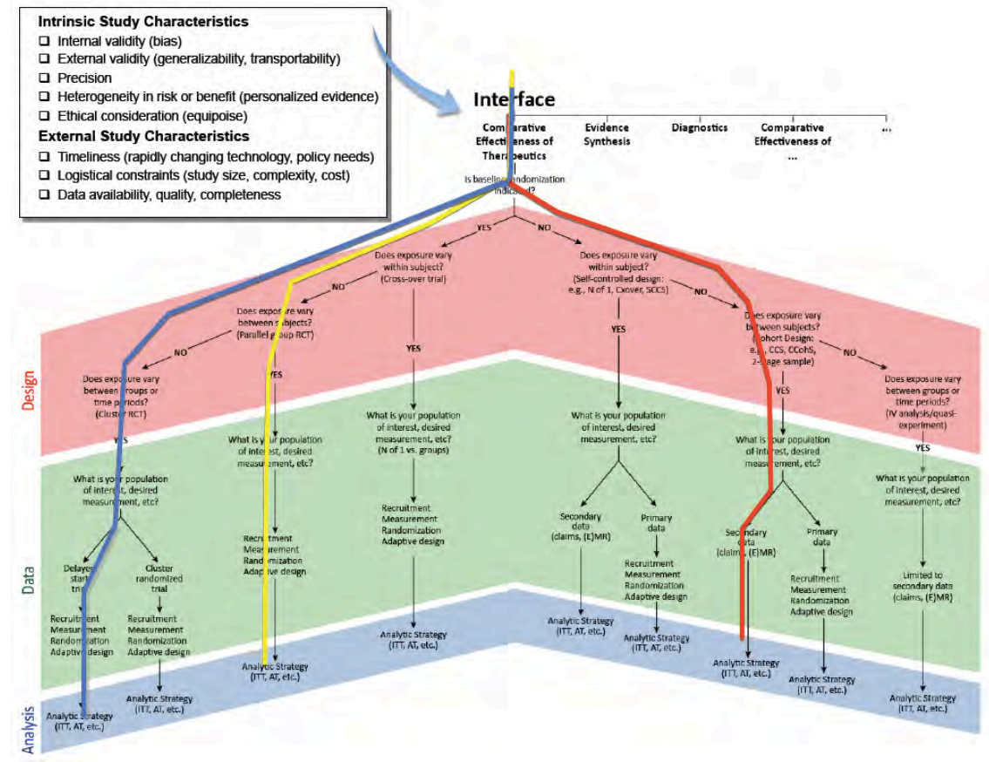
Les Standards du PCORI [2012]
Preliminary Draft Methodology Report:“OurQuestions,OurDecisions: Standards for Patient--‐centered Outcomes Research. PCORI 2012 p 164
Notes:
10

Slide 11
Evolution of Post Marketing Activity
Benefits
Risks
RCT’s in context of conditional approval
Spontaneous reporting
Payers requirements:
coverage with evidence development→ relative (comparative) effectiveness
Active surveillance
EU:Risk Management Plans:
Registries, Observational studies (eMedical Records)
LST’s : Large Simple Trial
Integrated assessment of clinical outcomes (the good and the bad)→ relative effectiveness: EU PAES

Slide 12
No Single Approach Fulfill All Possible Needs for
CER Information
Models, Simulations
Indirect Comparisons, MTC
Phase I + II
Phase IIIa
Phase IVa
Phase IIIb
Phase IVb
Pragmatic Randomised Trials, Registers
BDMA,DataBank
Research
Risk Identification
Monitoring comparators
- Profile of efficiency and tolerance in daily practice
-stop Of TT, Switch, Association
1st effectiveness studies / comparative Tolerance
Epidemiological modeling
Monitoring comparators
Design Phase III protocols and selection of good comparators for EEC
Start dialogue with payers
Clinical Evaluation
Negotiating prices and
reimbursement
Modeling P / R to the comparators
Indirect comparisons, MTC
Creating registries
Sequential exploitation of the BDMA
12
S.Schneeweiss Clinical Pharmacology & Therapeutic 2011
Notes:
12

Slide 13
What will change with adaptive pathways?
Focus on licencing → Focus on patient access
Magic moment → Life cycle management
Big population → small population
RCT only → all designs
Prevision → Monitoring
Open utilisation → Managed utilisation

Slide 14
An Organising Framework
 | Can it works ? (efficacy) | Does it works ? (effectiveness) | Is It worth it ? (value)
EVIDENCE GENERATION
EVIDENCE SYNTHESIS
DECISION MAKING
CER/REA
HTA
EBM
Bryan Luce et al International Working Group for HTA advancement 2010
REA (Relative Effectiveness Assessments) ; EBM : Evidence Based Medecine; HTA : Health Technology Assessment .
Notes:
14

Slide 15
What Kind of Evidence : CER, EBM, HTA?
 | Can it works ? (efficacy) | Does it works ? (effectiveness) | Is It worth it ? (value)
EVIDENCE GENERATION
EVIDENCE SYNTHESIS
DECISION MAKING
PCT
RCT
Registries
CED
CBA
CEA
CER
HTA
BIM
SRE
MTC
_{Clinical guidelines}
EBM
PAYERS
MARKET Authorisation
PHYSICIANS
REA: Relative Effectiveness Assessments, HTA Health technology assessment ; EBM : Evidence based medecine RCT ^{: Ramdomized} ^{clinical trial ; PCT pragmatic} ^{clinical trial ; MTC : Mix} treatment comparison- ; SRE: Systematic review of evidencee ; CED : Coveragel e with evidence development; Relations controversées
15
Adapté de Bryan Luce et al International Working Group for HTA advancement 2010
Notes:
15

Slide 16
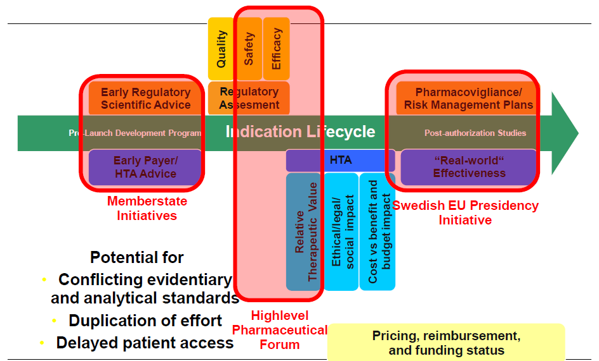
The EUnetHTA Project: A Chance or a Threat For HealthEconomic ?

Slide 17
¹⁷

Slide 18
Blurring the Distinction Between Pre and Post Commercialisation
Conditional marketing autorisation Orphan medicinal products, autorisation intended to be converted into regular autorisation once all data are available
Autorisation under exceptional circumstances Orphan drugs used in rare patient populations, normally it would never be possible to collect full data.
Accelerated review For drugs of major interest in terms of public health

Slide 19
A System Approach

