Slide 1
European Parallel Scientific Advice (PSA): a Pharma Company perspective
Nigel Cook
Global Patient Access, Novartis Pharma AG

Slide 2
Disclaimer
These slides are based on publicly available information (including data relating to non-Novartis products or approaches)
The views presented are the views of the presenter, not necessarily those of Novartis
These slides are intended for educational purposes only and for the personal use of the audience. These slides are not intended for wider distribution outside the intended purpose without speaker approval
The content of this slide deck is accurate to the best of the presenter’s knowledge at the time of production

Slide 3
Agenda
Evolution of scientific advice procedure in Europe
The case for Parallel Scientific Advice
Parallel Scientific Advice with the EMA and European HTAs
Process
Experiences of different stakeholders
Novartis’ experience
Learnings and looking ahead with Parallel Scientific Advice
Getting the most out of the PSA process
Where next?

Slide 4
Centre for Innovation in Regulatory Science Evidentiary Requirements in Clinical Development: Workshop to Synchronize Phase 3 requirements to meet multiple needs, 31st Mar – 1st Apr 2011, Geneva
General Recommendations
Sponsors should be encouraged to make early contact and keep dialogue open with regulatory and HTA authorities
Seek agreement between HTA and regulatory authorities on the choice of endpoints and comparators; indirect comparators should be considered where necessary to expedite a medicine’s review, especially when being considered for critical conditions with few medical alternatives
Map the current landscape of early HTA and HTA/regulatory advice procedures, including those planned, piloting and established, and better understand the impact of this advice
Develop joint HTA/regulatory guidance in important therapy areas to build on regulatory guidance – use “game changing” products as opportunity to drive scientific underpinnings of common ground
Proactively explore HTA/regulatory joint/parallel advice in the post-authorization space, as this may represent an opportunity for greater alignment

Slide 5
The move towards Parallel (or Joint) Scientific Advice
Strategy for EU Cooperation on Health Technology Assessment*
EU Health Technology Assessment Network, Oct 2014
‘”The Network calls upon:
HTA bodies to take part in parallel early dialogue with technology developers
Technology developers to engage in early dialogue and scientific advice processes involvinmg both regulators and HTA bodies”
Adopted unanimously by the HTA network, Rome, 29 Oct 2014
EMA Guidance for companies requesting scientific advice & protocol assistance, May 2010
Applications for CHMP scientific advice / protocol assistance and advice from Health Technology Assessment bodies in parallel are possible and welcome.
2010
2011
2014
ISPOR, Madrid, 5-8th Nov 2011
Health Policy & Issues Symposium:
“It is always too early until it is too late: What can we learn from the pilots of multi-stakeholder consultations in early-stage drug development?”
Peter Kolominsky Rabas, U. Erlangen; Spiros Vamvakas, EMA, London; Ron Akehurst, U. Sheffield; James Anderson, GSK
Interactions between health technology assessment, coverage, and regulatory processes: Emerging issues, goals, and opportunities
C.Henshall et al., on behalf of the HTAi Policy Forum. International Journal of Technology Assessment in Health Care, 27:3 (2011), 253–260.
* http://ec.europa.eu/health/technology_assessment/policy/network/index_en.htm

Slide 6
The evolution of different scientific advice procedures ... provides manufacturers the opportunity to select the advice process that best fits the questions they have
CHMP/EMA scientific advice from regulators (for >10 years)
National-level HTA advice (UK, Sweden, Australia, Netherlands, Germany ...)
National-level regulatory + HTA advice (e.g. MHRA & NICE in UK)
Multi-country HTA advice (e.g. EunetHTA SEED pilots from 2012)
Joint or Parallel Scientific Advice (PSA) – multi-country HTA and EMA
First pilots convened through Tapestry Networks in 2010
Pilots directly with EMA and EU HTAs began in 2011
EUnetHTA/SEED ran 3 pilots with multi-HTA and EMA in 2014
NICE only advice, might be appropriate if you wanted to go deep into the economic modeling or cost-effectiveness analysis
Parallel scientific advice would be preferred if there were questions around trial design and comparator choice

Slide 7
Why Parallel Scientific Advice?
Post regulatory approval, patient access is increasingly controlled and/or influenced by HTAs
One collaborative discussion, all key stakeholders in one room
Aim to avoid differing advice from regulatory and payer/HTA bodies
Optimize development plans and evidence generation (clinical trial comparators, endpoints, PROs, follow-ups etc; real world data plan; economic evidence)
Appreciation & understanding of each other’s point of view
Shared views (even consensus/alignment) across European HTA bodies
Early interaction and engagement with key decision-makers
Openness and interest to engage in the scientific dialog
Allows the pharma company the opportunity to address their issues and develop new evidence meeting the needs of stakeholders
Identify efficiencies for drug development, focus attention on the most meaningful and value-adding evidence generation
and ultimately, to facilitate the access of patients in need to new and innovative medicines offering real therapeutic added value

Slide 8
EUnetHTA SEED (“Shaping European Early Dialogues”) Pilots
http://www.earlydialogues.eu/has/
Project funded by the European Union in the framework of the EU Health Program 2008-2013
Pilots from October 2013 – August 2015, are being led by Haute Autorité de Santé (HAS, France) with participation of 13 other European HTAs
EMA will participate in 3 of the 7 advice procedures, others will be HTAs only
allows prospective input from HTA bodies on the clinical development program of the health technology
focuses during phase II to discuss the content of the planned Phase III i.e. planned confirmatory trial(s) and the economic rationale
Questions should be related to HTA in view of reimbursement and pertaining mainly to relative effectiveness, economic aspects and other areas relevant for reimbursement
The advice is not binding
Intention is to work towards a more permanent model for early dialogue

Slide 9
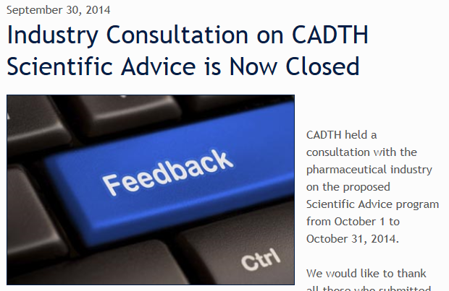
Canada’s CADTH is currently establishing an early scientific advice process
Official announcement expected around 1 Dec 2014
Program expected to launch from start of 2015
Of note:
Companies will be asked to provide patient engagement activities they have conducted as part of the briefing book.
CADTH also plans to solicit input from patients/patient groups as part of preparation for the advice meeting
http://scientificadvice.cadth.ca/en/news/2014/9/30/industry-consultation-on-cadth-scientific-advice-is

Slide 10
Agenda
Evolution of scientific advice procedure in Europe
The case for Parallel Scientific Advice
Parallel Scientific Advice with the EMA and European HTAs
Process
Experiences of different stakeholders
Novartis’ experience
Learnings and looking ahead with Parallel Scientific Advice
Getting the most out of the PSA process
Where next?

Slide 11
Summary of the EMA/HTA process for PSA
Time (months)
-6
-4
-2
0
+1
Pre-notification
Pre-validation
Validation
Advice Meeting
Outputs
Approach EMA to fix date
Approach HTAs
Confirm HTA participants
Letter of Intent
Draft of intended Qs
Scoping t/c (Pharma, EMA)
Submit draft briefing book (BB) to EMA & HTAs
Pre-validation t/c (Pharma, EMA, HTAs)
Revise & submit final BB and materials
Prioritize questions, prepare meeting flow
Pre- face-to-face t/c (EMA, HTAs)
4 hour face-to-face meeting
EMA and 1 HTA co-chair
KOLs, patient representative & others may be invited as required
Pharma drafts minutes & shares
HTA/EMA inputs incorporated, revised minutes issued
EMA and some HTAs issue final written advice
The advice is non-binding
Clarify questions and company position, confirm information is sufficient and appropriate
For further details: http://www.ema.europa.eu/ema/index.jsp?curl=pages/regulation/general/general_content_000049.jsp&mid=WC0b01ac05800229b9

Slide 12
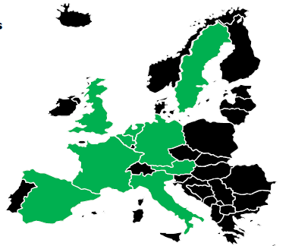
A recent perspective from the EMA: “Scientific advice throughout the life-cycle of the product” Spiros Vamvakas, Head of Scientific Advice, Product Dev’t Scientific Support Dept., EMA
As of September 2014:
34 PSA procedures done
5 currently ongoing
Common discussions around elements which are necessary for the benefit/risk assessment (Regulators) and for added value (HTAs)
Comparator: placebo, active comparator
Clinical endpoints: Survival, quality of life
Trial duration
Patient population to be included pre/post-marketing
http://www.ema.europa.eu/docs/en_GB/document_library/Presentation/2014/11/WC500177752.pdf

Slide 13
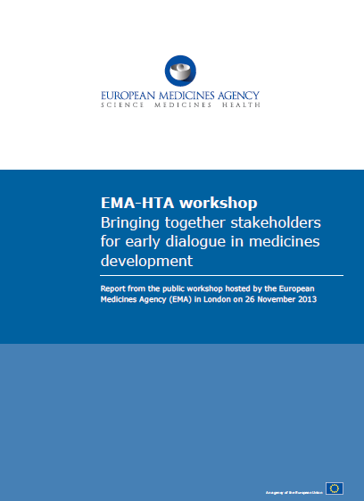
EMA Workshop on Early Scientific Advice
London, 26th November 2013
Workshop was heavily (over-) subscribed
>300 participants
EFPIA Industry Survey results shared: 23 pharma companies contributed 12 with experience of the scientific advice process 7 had experience of PSA with EMA + multiple HTAs:
84% said they found the advice very useful or moderately useful
8 companies said they intended to use the PSA process again in the next two years (none of the companies in the survey said “No”)
Suggestions for improvement: optimizing the procedure with process guidance, clear ownership, HTA engagement, clear HTA outputs, expertise in meetings, procedure flexibility and streamlining
http://www.ema.europa.eu/ema/index.jsp?curl=pages/news_and_events/events/2013/06/event_detail_000721.jsp&mid=WC0b01ac058004d5c3

Slide 14
Novartis’ experience with Parallel Scientific Advice
5 projects completed, 2 more currently being prepared
2011
2012
2013
2014
Rheumatoid arthritis
Food allergies
Heart failure
Uveitis
Cachexia

Slide 15
Some typical Questions discussed during PSA
Do the agencies agree that a composite endpoint is clinically relevant and appropriate as the primary endpoint in the phase III outcomes trial?
Is the proposed target patient population and the strategies to identify those subgroup(s) at higher risk appropriate?
Is a placebo comparator reasonable?
Do the agencies consider the key secondary endpoints appropriate for supporting registration and reimbursement?
Can we use a disease-specific rating scale rather than EQ5D?
In the absence of an approved standard of care, what would be an appropriate comparator to demonstrate the cost-effectiveness
Do the agencies agree that the economic model and evidence proposed would be sufficient to support reimbursement?

Slide 16
Novartis’ experience with Parallel Scientific Advice
5 projects completed, 2 more currently being prepared
2011
2012
2013
2014
Rheumatoid arthritis
Food allergies
Heart failure
Uveitis
Cachexia
Guidance led to cancelling one planned clinical study; important input on genetic/biomarker selection
Clarity provided on preference between two quite different development scenarios to enhance chance of success
Clear guidance on choice of comparator and endpoints in outcomes study
Informed the CDP, alignment on endpoints and use of rating scales; need to better define target population
Agreement on clinical program & endpoints.
Input on biomarker plan and to shape the QoL measures
The quality of discussion and flow has improved since the early advice meetings
Regulators and HTAs ready to challenge each others viewpoint
HTAs looking to align with each other, rather than sticking with different demands
CDP – clinical development plan
QoL - Quality of Life

Slide 17
Agenda
Evolution of scientific advice procedure in Europe
The case for Parallel Scientific Advice
Parallel Scientific Advice with the EMA and European HTAs
Process
Experiences of different stakeholders
Novartis’ experience
Learnings and looking ahead with Parallel Scientific Advice
Getting the most out of the PSA process
Where next?

Slide 18
Getting the most out of the PSA Process: Some of our Learning’s (1/2)
The Preparation
Solicit advice at a time when the responses can have a meaningful impact on development program (e.g. to inform phase III design)
Prepare well, start 6 months in advance, and ensure senior-level people are involved. Include senior leaders involved in subsequent decision-making
Be clear and transparent about the positioning and value proposition
Ask the difficult questions and don’t shy away from the issues
Note; the window can be narrow between having data to show and locking the plans for next stage of development
Process provides a great opportunity to align internal company views across functions
Better to have an open & transparent discussion, and to know the challenges ahead!

Slide 19
Getting the most out of the PSA Process: Some of our Learning’s (2/2)
The Meeting
Limit the number of questions, to allow a sufficient depth of discussion on each
Don’t invite too many HTAs (~4 works well), otherwise the discussion can get drawn out
Important to have a KoL present, and representation of patient’s perspective
Discussion which engages both the regulators and the payers are the most productive
Be open-minded to challenges/new suggestions, and prepared to adapt development program accordingly; have a collaborative mindset to find the best solution meeting needs of all stakeholders

Slide 20
Getting the most out of the PSA Process: Some of the Challenges
Significant logistics (not least in the interactions with several HTAs, rather than through one centralized process)
Not all HTAs are well resourced and staffed for offering scientific advice; this can become a problem as the process is adopted and expanded
Differences in HTAs, particularly in terms of methodologies around clinical benefit assessment and economic evaluations
But in reality, the similarities are more common than the differences!

Slide 21
What Next? Where is (Parallel) Scientific Advice headed
Efforts to coordinate better the HTA involvement in the PSA process and ongoing discussions at European Commission level to explore tighter alignment between EMA and HTAs throughout the life-cycle
EU HTA Network, EUnetHTA SEED pilots, EUnetHTA Conference, Rome 30-31 Oct 2014…establishment of a more permanent process?
More countries also offering single-country HTA (or HTA/regulatory) advice (GBa, AIFa, CVZ, TLV, CADTH, PBAC)
Question: could the assessment of the ‘clinical benefit’ (efficacy, relative efficacy/ effectiveness) be harmonized across EMA and European HTAs, leaving member states to then address the economic aspects at local level?
Question: is there an opportunity to develop disease pathway ‘points to consider’ guidance documents to include both a regulatory and pan-EU HTA perspectives?
Adaptive Licensing Pilots: Multi-stakeholder discussions, as during the early PSA process, are mutually supportive of the Adaptive Pathways initiative http://www.ema.europa.eu/ema/index.jsp?curl=pages/regulation/general/ general_content_000601.jsp&mid=WC0b01ac05807d58ce

Slide 22
Concluding Remarks
PSA process is now well established with EMA / EU HTAs and here to stay
Scientifically rigorous process, constructive engagement & collaboration. Discussions have been very objective, not polarizing
Desire to understand differences, with this deeper understanding providing a foundation to even explore common solution / consensus recommendations
There were more similarities identified in viewpoints than differences!
Clear value in Regulators and HTAs being around the same table
Improvements to development plans and evidence collection strategies should lead to new therapies which better address unmet medical needs and improve access for patients

