Slide 1
Health Policy & Health Economics: So Close and Yet So Far Away
Bill Swan, Deputy CEO
International Health Economics Association
2nd SEPD Health Economics Conference
Ankara, Turkey, December 4-5, 2014

Slide 2
What I’ll Do
Who I Am? What is iHEA?
What is Health Economics? History & Status
What is Health Policy?
What Happens When They Intersect
2nd SEPD Health Economics Conference
Ankara, Turkey, December 4-5, 2014

Slide 3
What iHEA Does
Past iHEA Conferences: Vancouver, Rotterdam, York, San Francisco, Barcelona, Copenhagen, Beijing, Toronto, Sydney, Dublin (with ECHE)
Upcoming iHEA Conferences: Milan, Boston, Basel
Conference Support: ASHEcon (Madison, Duke, Cornell), ECHE (Helsinki, Zürich), Health Systems Global (Beijing)
Web Site: New Update Pending
Membership Services
Investigating: Webinars, Official iHEA Journal
2nd SEPD Health Economics Conference
Ankara, Turkey, December 4-5, 2014

Slide 4
If Only It Were So …
“The art of economics consists in looking not merely at the immediate but at the longer effects of any act or policy; it consists in tracing the consequences of that policy not merely for one group but for all groups”
- from Economics in One Lesson, Henry Hazlitt,1946
2nd SEPD Health Economics Conference
Ankara, Turkey, December 4-5, 2014

Slide 5
What is Health Economics?
Application of the Economic “Tool-kit” to Health
Pre-Malthus & early MD Work Suggest HE Older than Thought
Identifiable Committee Work late ’20s Early ’30s
‘60s: Health/Finance Min.’s, WB, WHO, Medical Assoc.’s & Insurance
Distinct Sub-field prospered 1960-2000 to stability & maturity
Dominated by Arrow Paper & Grossman Model
2nd SEPD Health Economics Conference
Ankara, Turkey, December 4-5, 2014

Slide 6
Growth of Health Economics
No Census or Licensure of Health Economists
Pre-1960 Doubtful as Sub-Discipline, Smattering of Researchers
Economists, MD’s, Accountants, Demographers, Political Scientists
1970 < 3 dozen
Slight increase by 1980 in Rotterdam. 300+ in Zürich 1990
1st iHEA membership directory in 1997 had 1100. Now 2500+
1 HE / 200,000 in countries with established programs (slowing)
Growth of Health Economics Now in Developing Countries
2nd SEPD Health Economics Conference
Ankara, Turkey, December 4-5, 2014

Slide 7
Ideology in Health Economics
Narrow Neo-Classicists vs Broad Eclectics
Viewed by Some as the “Slum” of Economics or Mere Dalliances
UK vs US: “Two Disciplines Separated by a Common Language”
Market Economic Assumptions
Normative vs Positive Economics
2nd SEPD Health Economics Conference
Ankara, Turkey, December 4-5, 2014

Slide 8
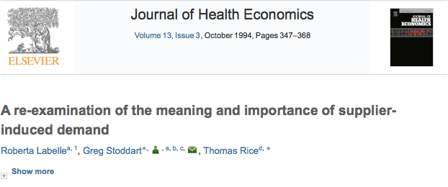
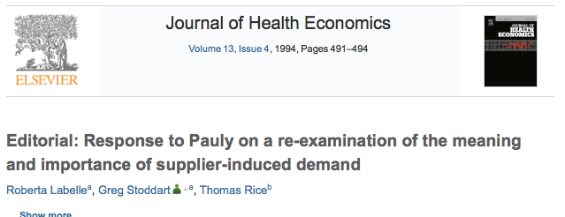
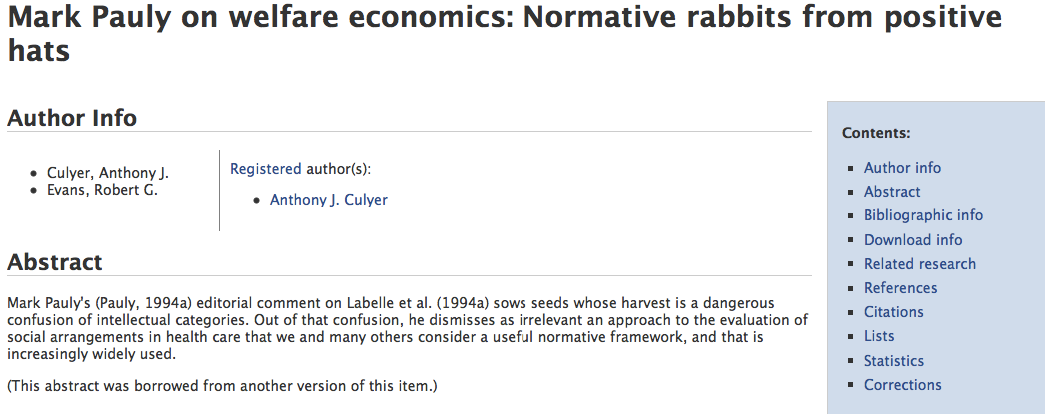
Academic Discord
2nd SEPD Health Economics Conference
Ankara, Turkey, December 4-5, 2014

Slide 9
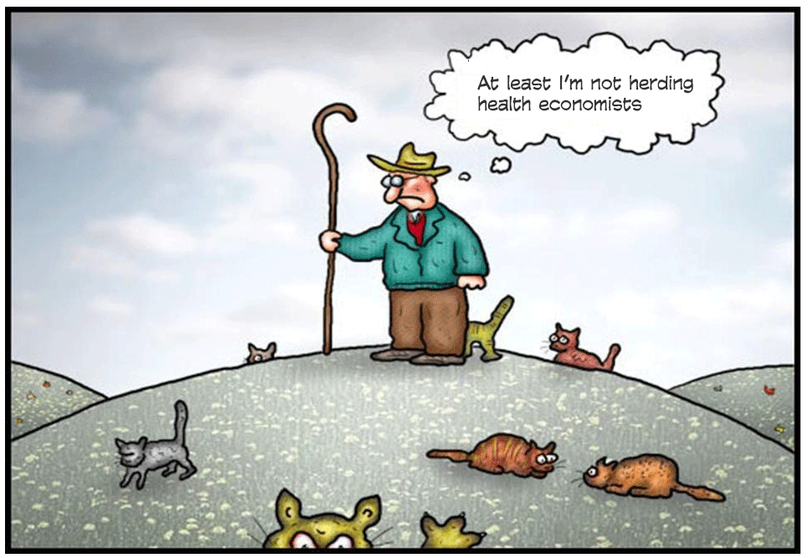
One Lucky Cat-herd …
2nd SEPD Health Economics Conference
Ankara, Turkey, December 4-5, 2014

Slide 10
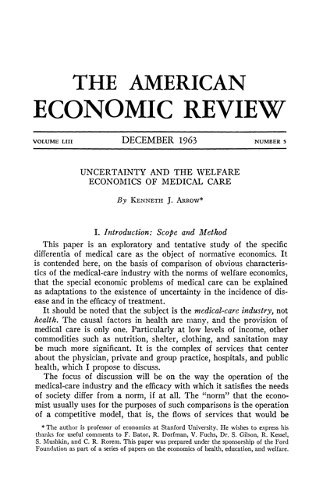
…And So It Begins
2nd SEPD Health Economics Conference
Ankara, Turkey, December 4-5, 2014

Slide 11
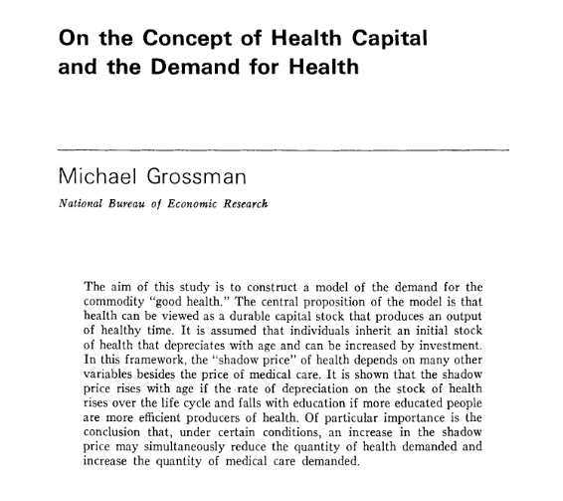
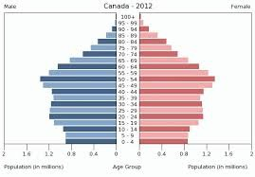
Grossman Model
2nd SEPD Health Economics Conference
Ankara, Turkey, December 4-5, 2014

Slide 12
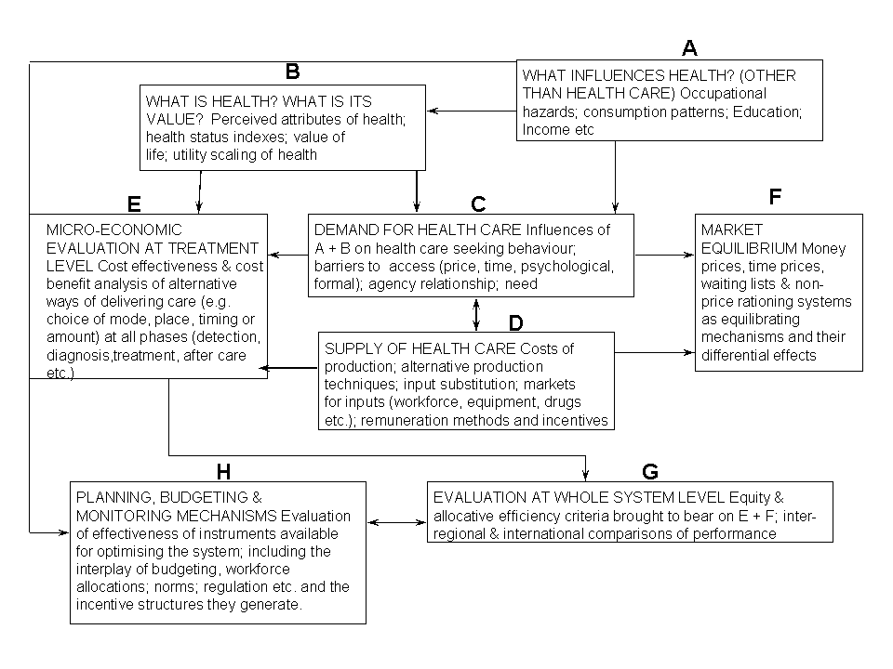
“The” Diagram
2nd SEPD Health Economics Conference
Ankara, Turkey, December 4-5, 2014

Slide 13
Academic Output & Integrity
Health, Education & Welfare Papers” fell 2.6% to 1.1% 1886-1963
Health Papers Increased 3% to15% from 1969-1990
Medline: 50 (1966-74), 2900 (1975-83), 7550 (1984-1992)
Increase of 350% for Health Papers in EconLit 1991-2000
Wagstaff/Culyer: 69-80 (1K), 90 (4K), 2000 (14K), 2010 (33K)
2nd SEPD Health Economics Conference
Ankara, Turkey, December 4-5, 2014

Slide 14
Academic Health Economists
2nd SEPD Health Economics Conference
Ankara, Turkey, December 4-5, 2014

Slide 15
Health Policy-Makers
2nd SEPD Health Economics Conference
Ankara, Turkey, December 4-5, 2014

Slide 16
What is Health Policy?
Decisions Made to Achieve Specific Health and Health Care Goals Within Society
Categories: Public Health, Personal Health, Pharmaceutical, Hospital, Provider, etc., etc.
Levels May Include Financing and Delivery of Health Care, Access, Quality of Care, Equity, etc., etc.
Health Often Viewed as the Third Rail of Politics
2nd SEPD Health Economics Conference
Ankara, Turkey, December 4-5, 2014

Slide 17
What Drives/Impacts Health Policy?
Politics & Ideology
Bureaucracy
Perceptions
Demographics
“Decision-Based Evidence Making”
“Zombies”
2nd SEPD Health Economics Conference
Ankara, Turkey, December 4-5, 2014

Slide 18
Who Really Makes Health Policy?
2nd SEPD Health Economics Conference
Ankara, Turkey, December 4-5, 2014

Slide 19
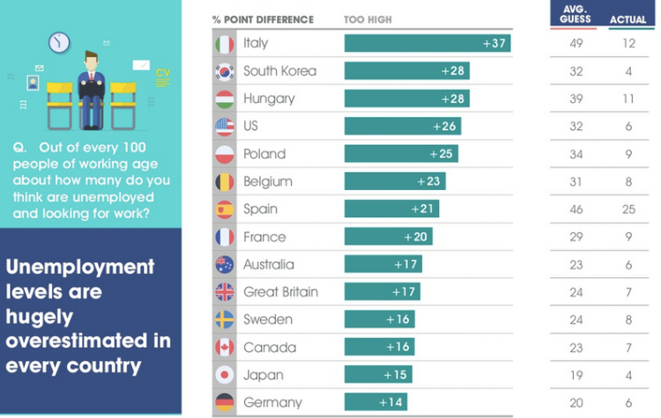
Perceptions
2nd SEPD Health Economics Conference
Ankara, Turkey, December 4-5, 2014

Slide 20
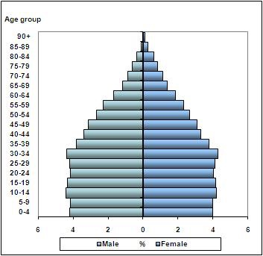
Health Policy vs Demographics:
Turkey 2012
2nd SEPD Health Economics Conference
Ankara, Turkey, December 4-5, 2014

Slide 21
Health Policy vs Demographics: Canada 2012
2nd SEPD Health Economics Conference
Ankara, Turkey, December 4-5, 2014

Slide 22
Health Policy vs Demographics
2nd SEPD Health Economics Conference
Ankara, Turkey, December 4-5, 2014

Slide 23
Intersection?
2nd SEPD Health Economics Conference
Ankara, Turkey, December 4-5, 2014

Slide 24
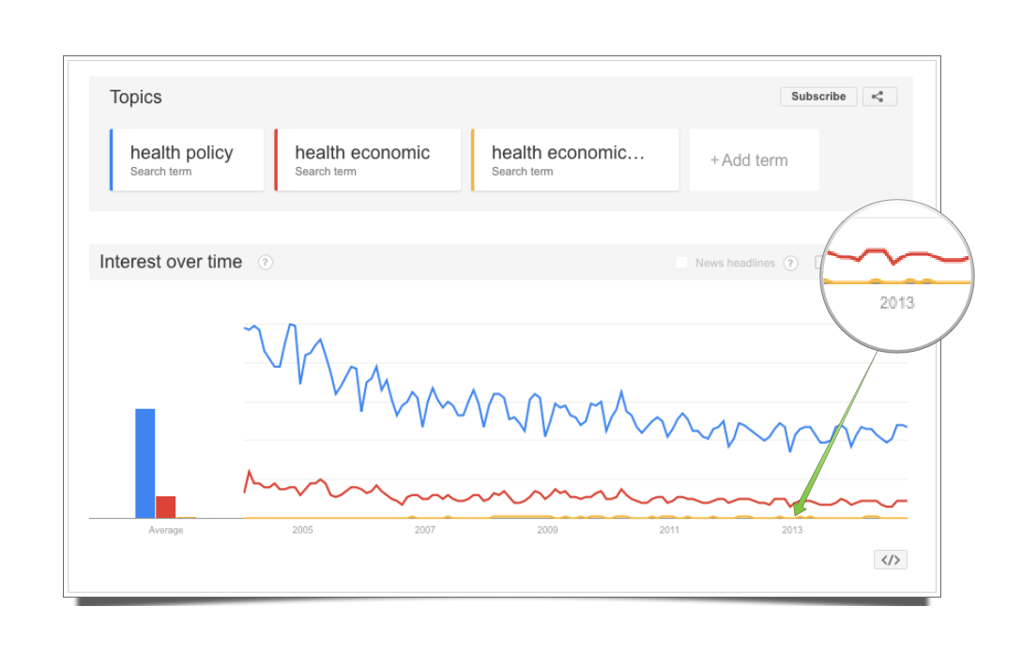
Health, Economics & Policy
2nd SEPD Health Economics Conference
Ankara, Turkey, December 4-5, 2014

Slide 25
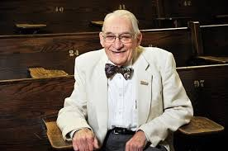
Canada
Hall Commission
Lalonde Report
Province Led/Federal Fiscal Lever
Canada Health Act 1982
Malaise
Arguably Worst Single-Payer System in the World
Jack Boan
2nd SEPD Health Economics Conference
Ankara, Turkey, December 4-5, 2014

Slide 26
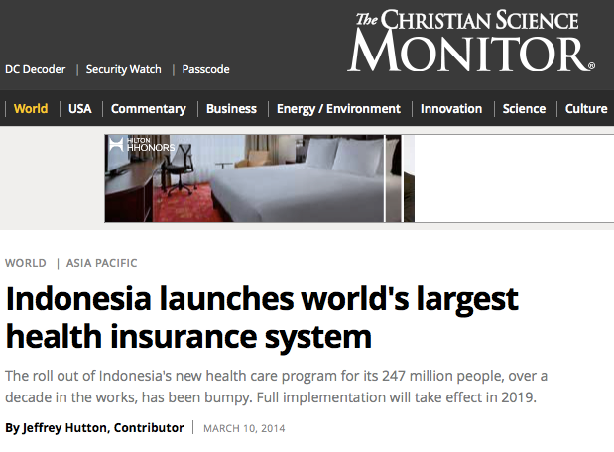
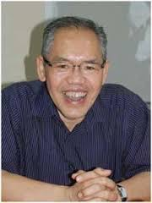
Indonesia
247 Million Citizens
18,000 Islands
700 Languages
Hasbullah Thabrany
2nd SEPD Health Economics Conference
Ankara, Turkey, December 4-5, 2014

Slide 27
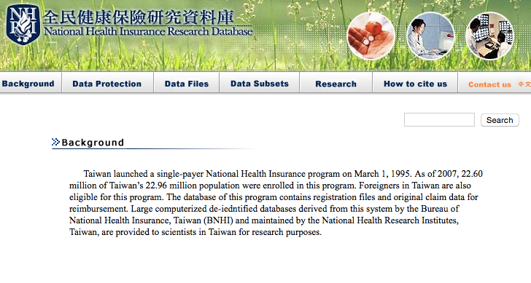
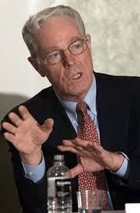
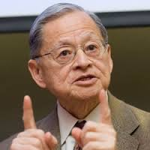
Taiwan
National Health Insurance
Data, Data, Data
Bill Hsiao/Uwe Reinhardt
2nd SEPD Health Economics Conference
Ankara, Turkey, December 4-5, 2014

Slide 28
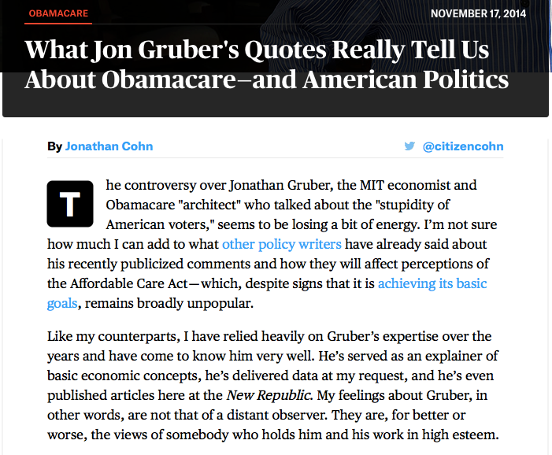
Whoops!?
2nd SEPD Health Economics Conference
Ankara, Turkey, December 4-5, 2014

Slide 29
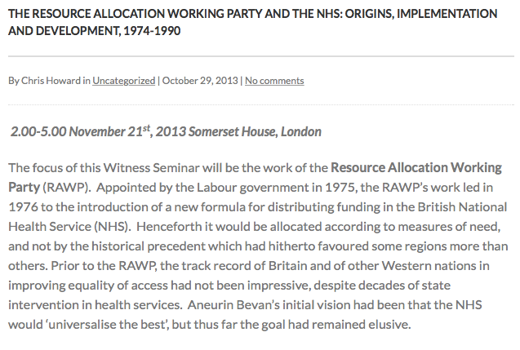
RAWP
2nd SEPD Health Economics Conference
Ankara, Turkey, December 4-5, 2014

Slide 30
What Ken Arrow Learned …
2nd SEPD Health Economics Conference
Ankara, Turkey, December 4-5, 2014

Slide 31
Winning Conditions?
Political Champion
Research Champion
Long-Term Commitment
Luck (alignment of ideology, accidental meeting, right place/right time, etc., etc.)
“…the best ideas come from careful and continuous social exploration”
“The most consistently creative and insightful people are explorers.”
“…they seek out people with different views and different ideas.”
2nd SEPD Health Economics Conference
Ankara, Turkey, December 4-5, 2014

Slide 32
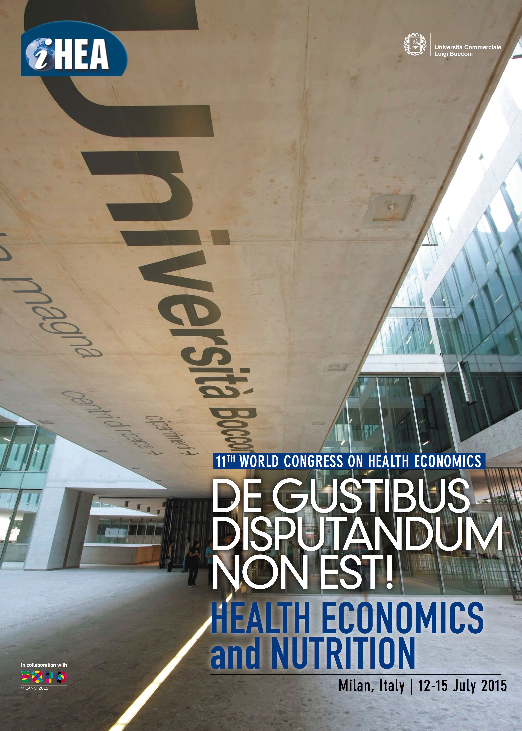
2nd SEPD Health Economics Conference
Ankara, Turkey, December 4-5, 2014

Slide 33
Thank You – Sağ Olun
2nd SEPD Health Economics Conference
Ankara, Turkey, December 4-5, 2014

